Slide 1

Project Title – Seasonal Agriculture Performance Analysis
Presented by: Skandashree R Dr. Ambedkar Institute of Technology
AICTE STU ID : STU6a41341341e4d1782658067

Slide 2

PROBLEM STATEMENT
Agricultural activities are influenced by seasonal variations in environmental conditions, farming practices, resource availability and market conditions. As a result, agricultural performance may differ from one season to another. However, raw agricultural data does not clearly explain how agricultural performance changes across seasons or what patterns can be observed in different seasonal conditions. The problem is to analyze the given agricultural dataset and investigate seasonal differences in agricultural performance by identifying meaningful patterns, trends, relationships and variations within the available data

Slide 3
Project Description
Seasonal Agriculture Performance Analysis is a data analytics project that examines agricultural activities across different seasons, geographical areas, crops, and farming conditions.
The project involves:
Data exploration and cleaning to prepare the agricultural dataset for analysis.
Statistical analysis to understand distributions, variations, and overall performance.
Seasonal comparison to identify differences in yield, production, resource usage, and profitability.
Relationship analysis to study connections between environmental conditions, farming practices, and agricultural outcomes.
Data visualization using charts and graphs to clearly communicate important patterns.
Insight generation to support evidence-based agricultural planning and decision-making.
Project Workflow: Data Collection → Data Cleaning → Exploratory Analysis → Statistical Analysis → Visualization → Insights → Recommendations

Slide 4

WHO ARE THE END USERS?
The insights generated from this analysis can be useful for:
Farmers To understand seasonal and crop-wise performance and improve planning.
Agricultural Departments To support data-driven agricultural policies and planning.
Agricultural Planners To compare seasonal performance and resource requirements.
Resource Managers To understand water usage and efficiency.
Agricultural Analysts & Researchers To identify trends, relationships, and areas for further research

Slide 5

Technology Used
Programming & Analysis
Python
Pandas
NumPy
Data Visualization
Matplotlib
Seaborn
Development Environment
Google Colab

Slide 6
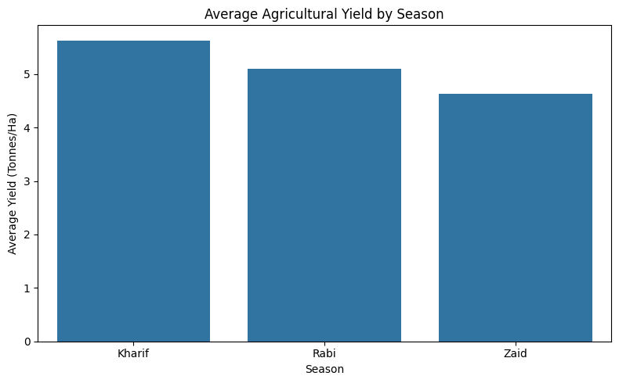
RESULTS : Seasonal Performance
Key Findings
Seasonal variations were observed in agricultural performance.
Kharif showed the highest average yield among the analyzed seasons.
Kharif also showed strong performance in average profit and total production.
Seasonal comparison helps identify periods with better agricultural outcomes.

Slide 7
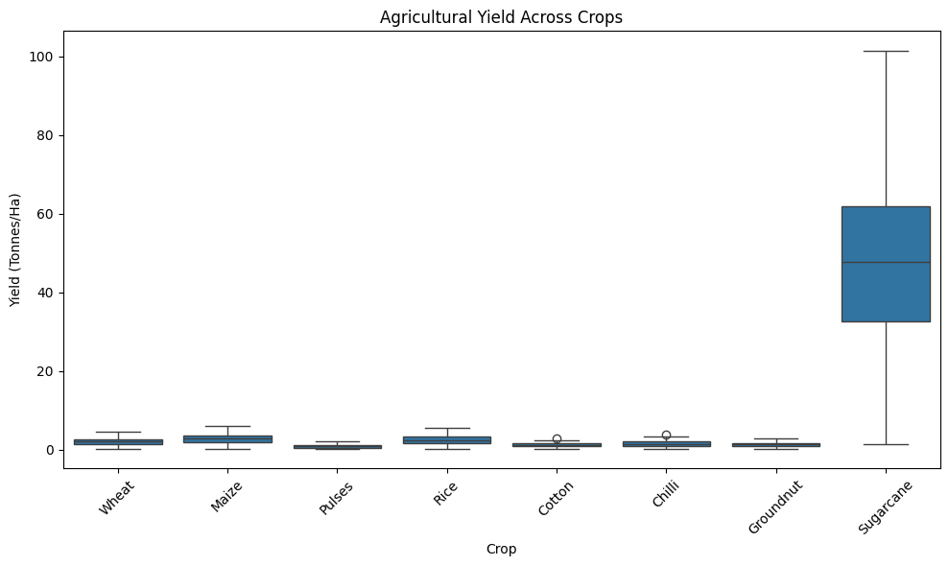
RESULTS : Crop Performance
Key Findings
Crop performance varies considerably across the dataset.
Sugarcane showed the highest average yield among the analyzed crops.
Sugarcane also showed strong average profitability.
Comparing crops helps identify high-performing agricultural categories.

Slide 8
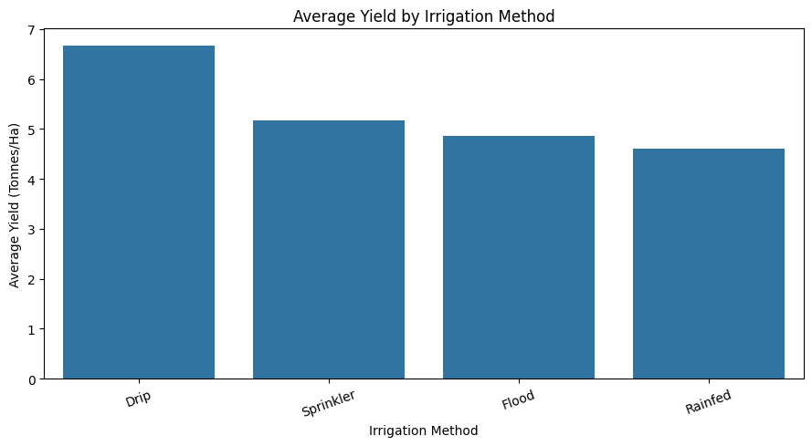
RESULTS : Irrigation & Water Efficiency
Key Findings
Irrigation methods showed differences in agricultural performance.
Drip irrigation showed the highest average yield among the analyzed irrigation methods.
Rainfed farming showed high water-use efficiency.
Efficient resource utilization is important for sustainable agricultural planning.

Slide 9
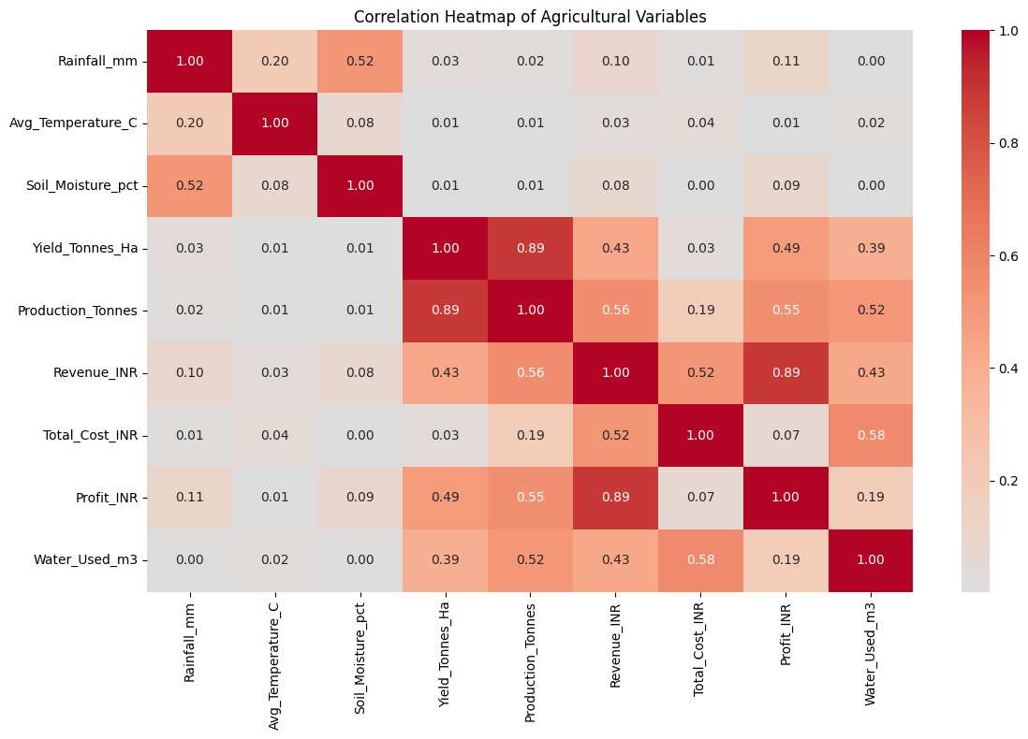
RESULTS : Correlation Analysis
Key Findings
Production and yield showed a strong positive relationship.
Profit and revenue showed positive relationships with agricultural performance.
Yield had a weak relationship with rainfall in the analyzed dataset.
Correlation analysis helped identify important relationships among agricultural variables.

Slide 10
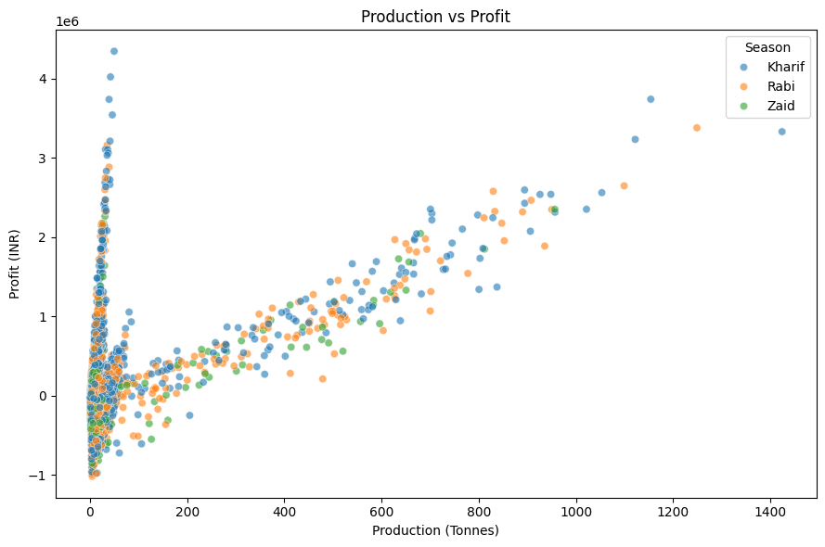
RESULTS : Production Vs Profit
Key Findings
Higher production does not necessarily guarantee higher profit.
Profitability is influenced by production cost and market price.
Some observations show high production but relatively lower or negative profit.
This highlights the importance of considering both production and economic factors when evaluating agricultural performance.

Slide 11
Future scope
The project can be further enhanced by:
Integrating real-time weather data
Incorporating larger and more recent agricultural datasets
Developing an interactive Power BI dashboard
Applying machine learning for yield prediction
Developing crop recommendation systems
Performing long-term seasonal trend analysis
Adding more regional and environmental variables
Developing a farmer-friendly decision-support system

Slide 12
GitHub Link
GITHUB REPOSITORY :
Seasonal Agriculture Performance Analysis
Repository Link Repository contains:
Colab notebook
Dataset
PPT
README

Slide 13
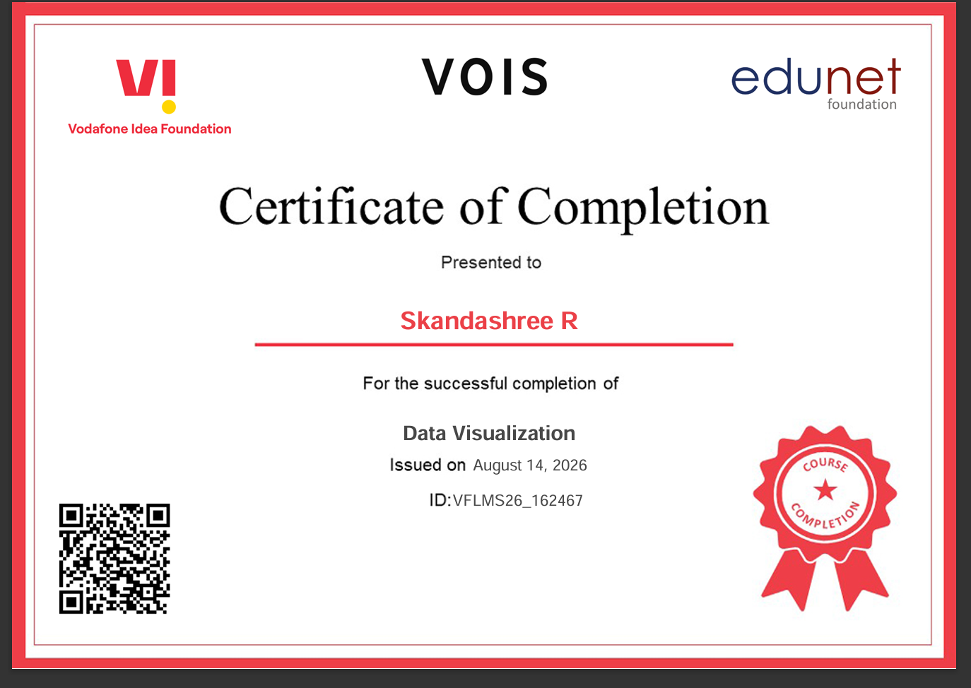
VOIS Course completion certificate - Course name- Data Visualization

Slide 14
Thank you
Seasonal Agriculture Performance Analysis
Presented by: Skandashree R
Major Data Analytics Project
.
.

